Slide 1
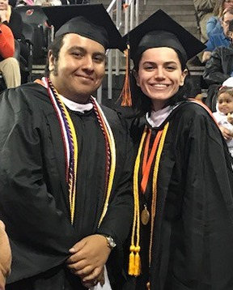
Getting Ready for Registration
February 2020
Barbara Andrew, Ph.D.
Dean of the Honors College
Notes:
The goal of this presentation is to prepare you for the registration process and to inform you of proper procedures and helpful hints.

Slide 2
Before registering…
Make a list of requirements for your major, the UCC, and for Honors
Develop a schedule for next semester
Schedule an advisement appointment
Request permits
See your advisor and get your alternate pin
Notes:
Before you can register for classes, there are a few things that you must take care of. We will go into further detail about each of these points later on in the presentation.

Slide 3
1. Make a list of requirements
You need to know the requirements for:
Your major
The UCC
Honors

Slide 4
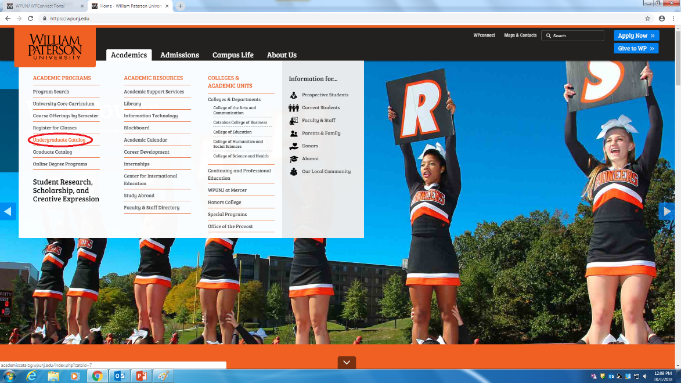
Major Requirements
What courses do you need for your MAJOR?
You can find the list of requirements for your major in the undergraduate catalog or in your degree evaluation

Slide 5
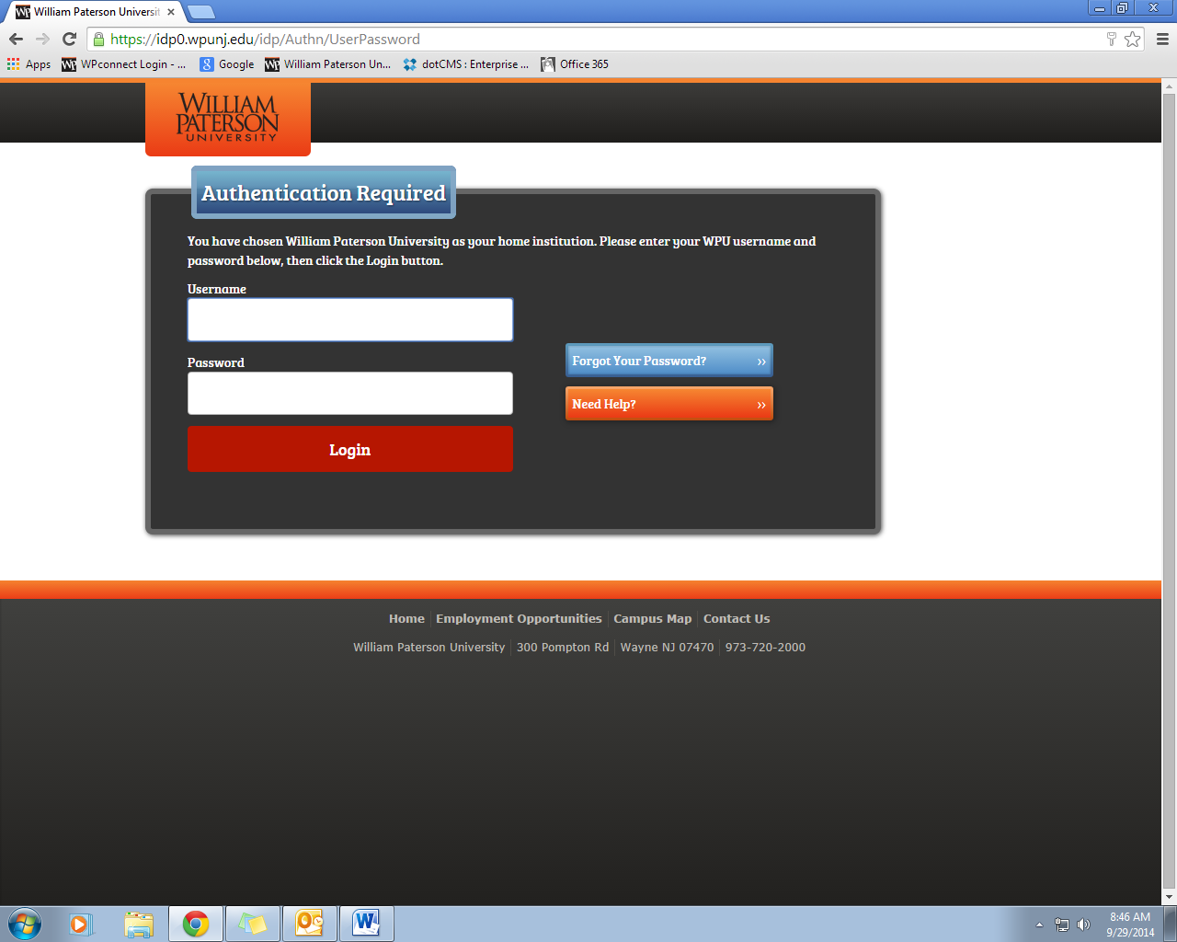
Degree Evaluation
If you have already declared a major, the best place to look for your requirements is your Degree Evaluation.

Slide 6
Open “Students” Tab
Notes:
After signing in, make sure to select the “Students” tab at the top of the page.

Slide 7
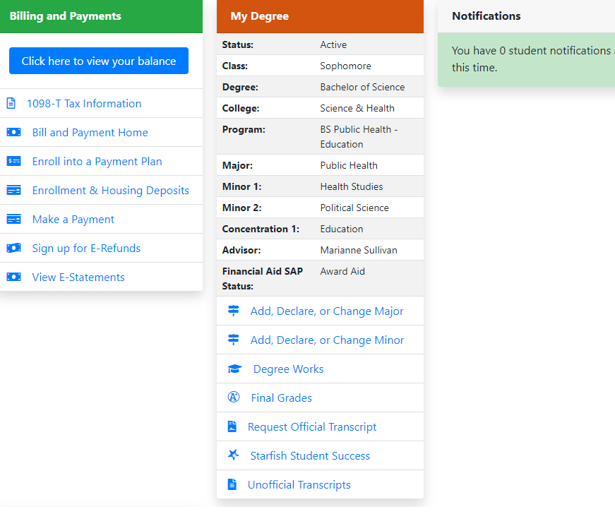
What courses do you need? Degree Evaluation

Slide 8
Your Degree Evaluation

Slide 9
Your Degree Evaluation

Slide 10
Major Requirements

Slide 11
Now you should have a list
1. Your Major requirements
2. Your UCC requirements
– even if you are undeclared, your degree evaluation lists your UCC requirements.

Slide 12
A minimum of one Honors Course
Every honors student must take at least one honors course each semester.
Choose an honors course that meets a UCC requirement that you still need or that is in a major or minor you want to explore or that has an experience you are interested in.
Fall 2020 – Honors UCC Courses. Courses are available by permit only. Please send an email to honors@wpunj.edu to request a permit.
Go to the Honors webpage: www.wpunj.edu/honors and click on Honors Courses. This page will be updated in March.

Slide 13
So, now you have: A list of courses for next semester
UCC 2c - ENG 1500 (honors)
UCC 3a - PHIL 1120 (honors)
UCC 3c - ECON 2020 (honors)
UCC 3e - MATH 1170
World languages FR 1100
Check the prerequisites for your courses
You must have 12-19 credits
Honors recommends 15-18 credits

Slide 14
8 Semester (4 Year Plan)
With the work you have done so far, you are almost ready to complete your 8 semester (4 Year Plan).
You can fill in your UCC and major requirements.
You need to add your Honors Track Courses. The list of Track Courses can be found in the Honors College Student Handbook on the Honors website.

Slide 15
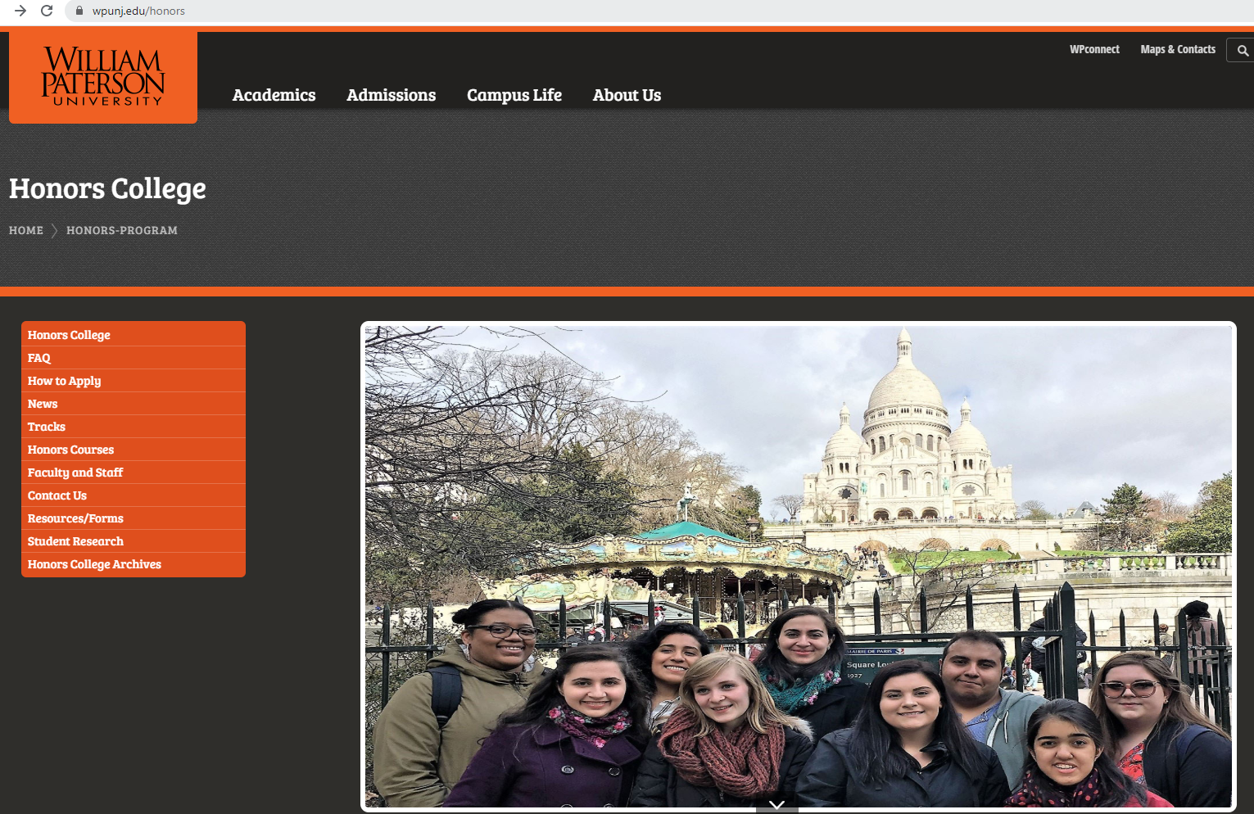
Honors Tracks
Go to the Honors webpage at www.wpunj.edu

Slide 16
8 Semester Plan – due at the next EO meeting

Slide 17
8 Semester Plan
Fill in the courses you have completed and are taking now. Include any credits you had before starting.
Add the courses required for your major. Make sure to note any pre-requisites. Some departments have a four-year plan on their website.
Add any UCC requirements you’ve not yet completed. Check your degree evaluation to make sure you have listed them all.

Slide 18
8 Semester Plan
4. Add your Honors courses. You need at least one Honors course in each future semester. Note that your Honors track courses count toward this requirement. Some track courses may have pre-requisites.
5. You need at least 12 credits a semester to be full-time. You need 15 credits a semester to graduate in four years. You need a minimum of 120 credits and to have completed all requirements in order to graduate.

Slide 19
2. Make a schedule
Notes:
The benefit of priority registration is that you can design you own schedule, and that you will most likely get the section of the course that you desire.
Honors sections of UCC courses are posted on the Honors Curriculum webpage.

Slide 20
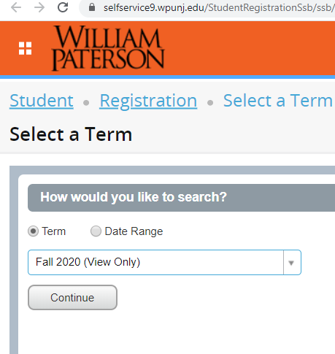
Select Term Date
Notes:
Be sure to select the correct semester.

Slide 21
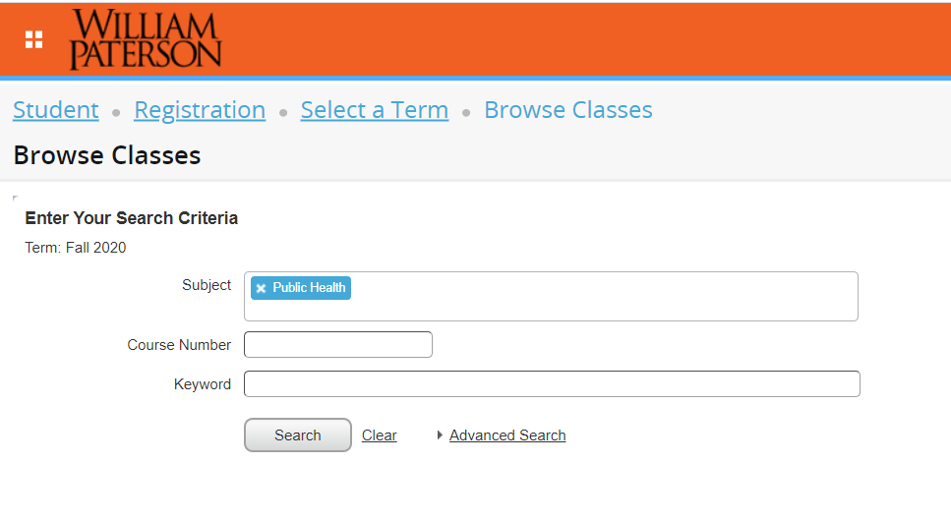
Select Subject and Course Search

Slide 22
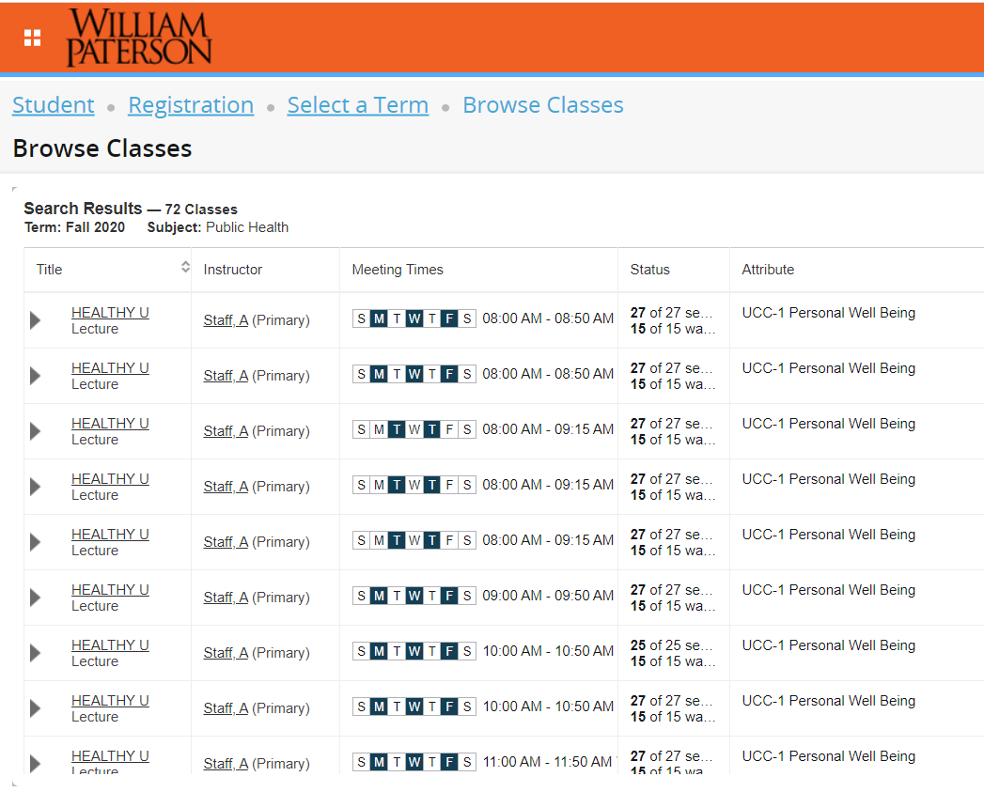
Select the course and click on View Sections

Slide 23
Find a section that works

Slide 24
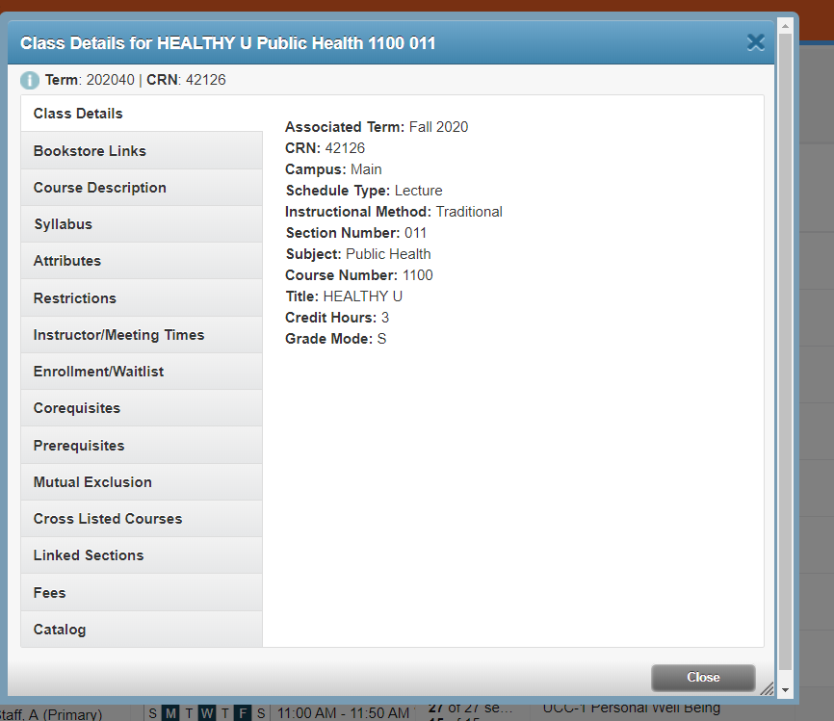
Select a Course
Notes:
To register, you will only need the CRN #.
If you need to request a permit, you will also need the course name, number, and section.

Slide 25
Work out a schedule and get CRNs

Slide 26
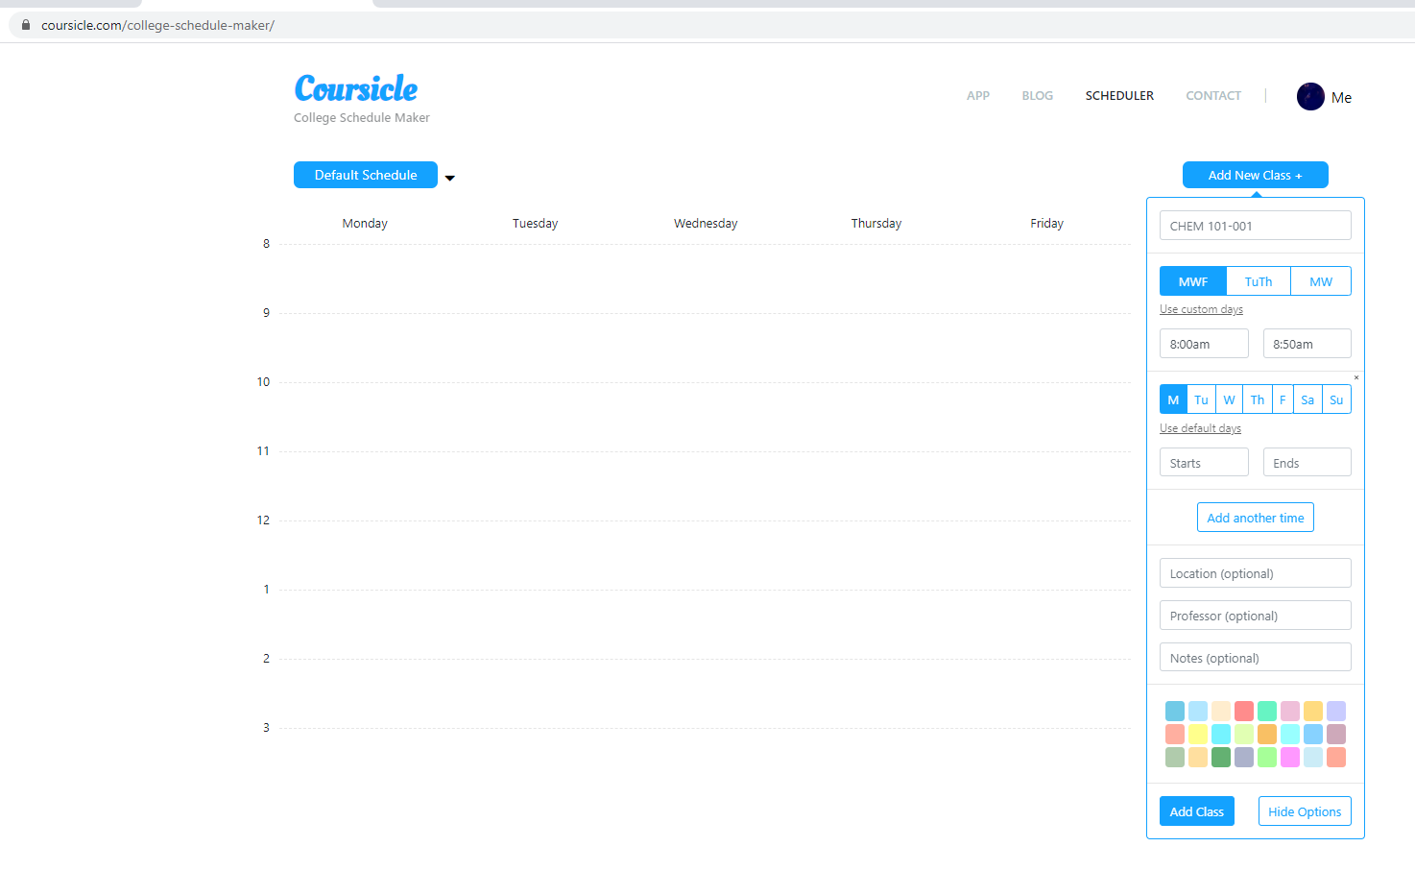
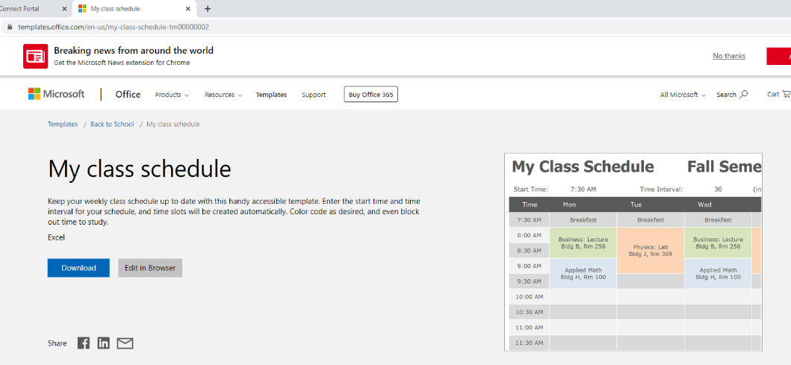
Or use an app
Coursicle
Office.com/templates

Slide 27
3. Make an advising appointment
If I am your advisor, you can make an appointment with me after today. I have sign up sheets. (If you aren’t ready to make an appointment, you can do this later).
If you have a different advisor (Music, Nursing and Art majors) email your advisor for an appointment.
April 6 is priority registration

Slide 28
Before you see your advisor
Get a list of courses together. The courses are for your major, the UCC and one Honors course.
Look up the courses and make a schedule for yourself. Copy down the course subject and number and the CRN.
Make a list of questions for your advisor.

Slide 29
Permit needed? Email the department!
Permits for Honors courses should go to Honors@wpunj.edu
All other permits go to the Department Chair or the Department Secretary of the course you need the permit for…Biology permits go to the Biology Department Chair, Dr. David Slaymaker, for example.

Slide 30
4. Request Permits
Request permits for Honors, Education, and Upper level courses (verify with your advisor/department)
Include the following information in all permit request emails:
Your Name
Your Student I.D. Number (855)
Course Title (Calculus II)
Course Number and Section (1610-02)
Course CRN Number (10300)
Notes:
Some courses require a permit in order for you to register.
It is not a “physical” permit, but rather special permission that is granted online.
Be as specific as possible when requesting a permit to ensure that you get the class and section that you want.

Slide 31
Email Etiquette
Email the department chair for a permit
Address the department chair by the proper title. Begin your email by writing something like “Dear Dr. Smith” or “Dear Professor Rodriguez.”
Remember that your email should be polite, formal and business-like. Don’t use slang language. Write in the style that you would write a business letter.

Slide 32
5. Go to your advisor with
1. A list of courses you plan to register for, including the course subject code, number, section number and CRN
2. A print out of your degree evaluation
3. A list of questions for your advisor.

Slide 33
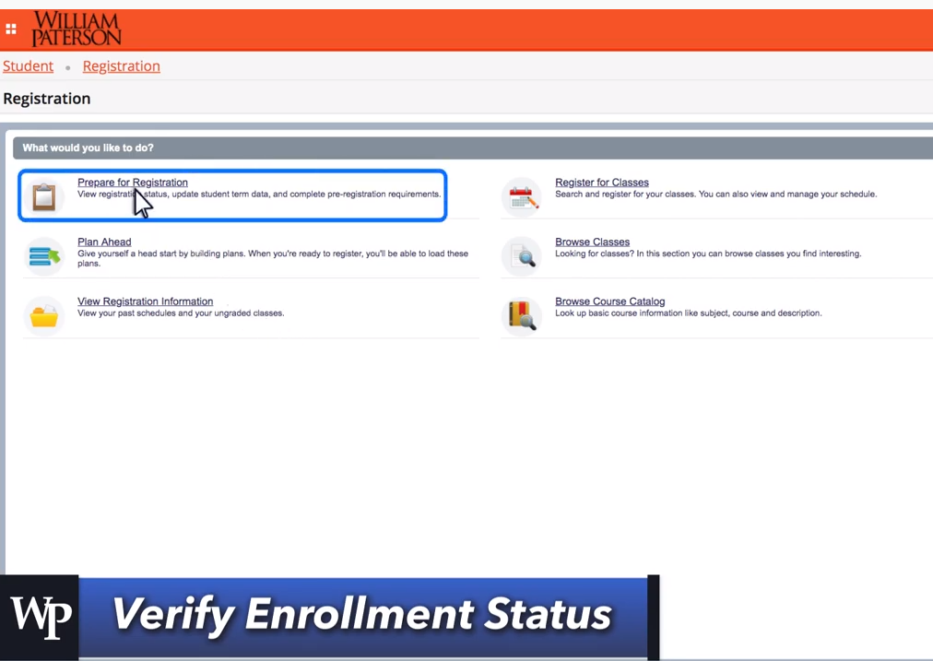
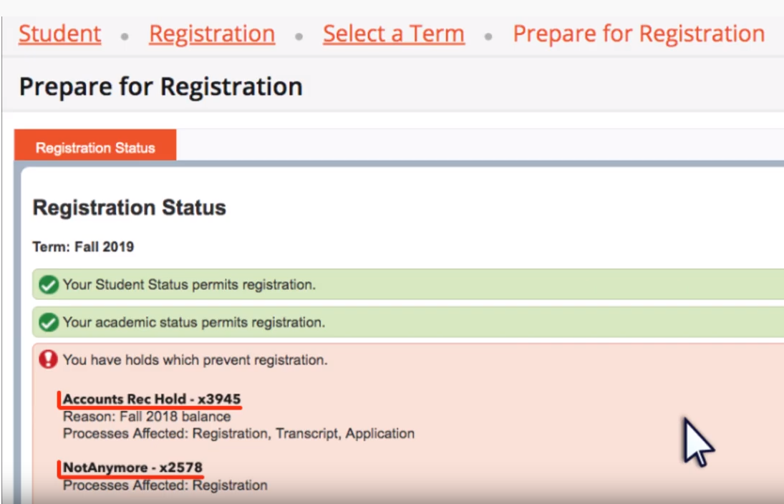
How to check for holds…
Student * Registration * Select Term * Prepare
The freshman hold will be lifted a few days before priority registration.
Other holds are a problem

Slide 34
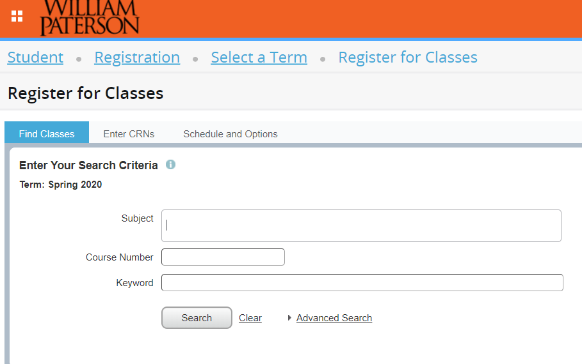
When Registering You Can: Search for Classes

Slide 35
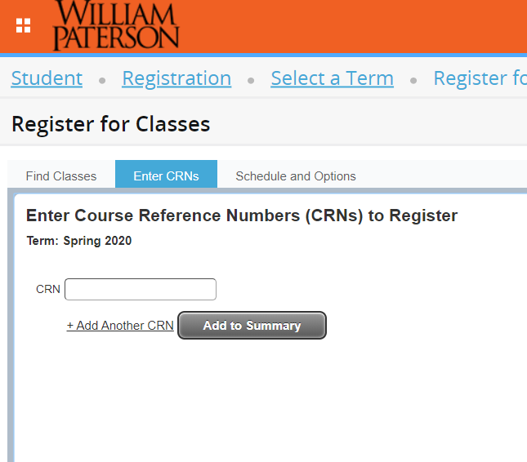
OR: Enter CRNS

Slide 36
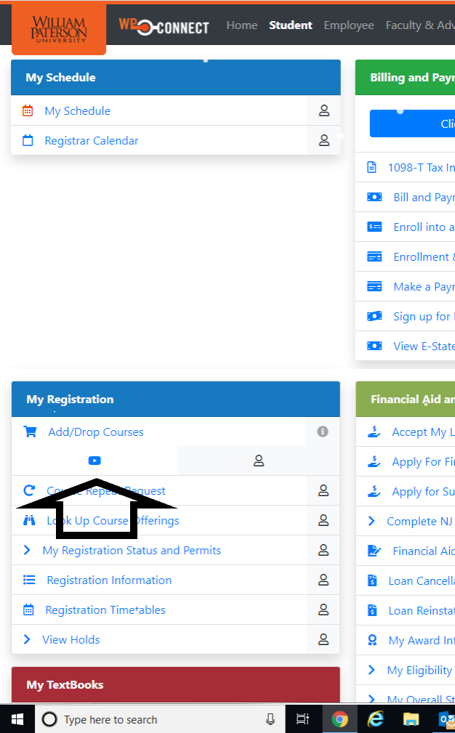
Video to remind you how to register
There is a video on WPConnect right under the add/drop button that shows how to register.
Registration video

Slide 37
You are responsible for your degree completion
Your advisor can only advise. You register for your courses. You make decisions about your best path to graduation.
It’s your responsibility to know what courses you need to complete your degree.

Slide 38
Need help?
Come to the Honors office

Slide 39
Spring Requirements
Attend March extended orientation meeting and hand in completed 8 semester plan
See your advisor
Attend at least 3 presentations during Honors Week (April 21-27)
Optional additional meeting with Dr. Andrew about CliftonStrengths

